Slide 1
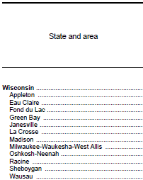
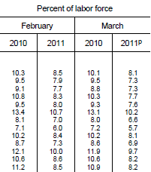
Bureau of Labor Statistics – Unemployment by Area
Notes:
BLS

Slide 5
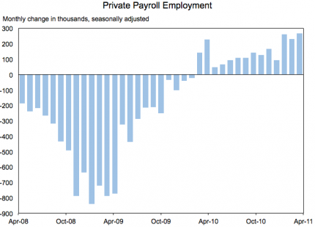
Notes:
Council of Economic Advisors

Slide 6
Bureau of Labor Statistics – Unemployment by Educational Attainment
 | Educational attainment | Apr. 2010 | Feb. 2011 | Mar. 2011 | Apr. 2011
Less than a high school diploma | Employment-population ratio | 39.4 | 39.2 | 39.8 | 38.9
 | Unemployment rate | 14.7 | 13.9 | 13.7 | 14.6
High school graduates | Employment-population ratio | 55.8 | 54.6 | 54.4 | 54.6
 | Unemployment rate | 10.5 | 9.5 | 9.5 | 9.7
Some college or associate degree | Employment-population ratio | 65.1 | 64.1 | 64.6 | 64.5
 | Unemployment rate | 8.3 | 7.8 | 7.4 | 7.5
Bachelor's degree and higher(2) | Employment-population ratio | 73.5 | 73.6 | 73.5 | 73.5
 | Unemployment rate | 4.8 | 4.3 | 4.4 | 4.5
Notes:
BLS
Table A-4. Employment status of the civilian population 25 years and over by educational attainment
HOUSEHOLD DATA
Table A-4. Employment status of the civilian population 25 years and over by educational attainment [Numbers in thousands]

Slide 7
Labor Market is crucial to economic recovery
“While indicators of spending and production have been encouraging on balance, the job market has improved only slowly. Following the loss of about 8-3/4 million jobs from 2008 through 2009, private-sector employment expanded by a little more than 1 million in 2010. However, this gain was barely sufficient to accommodate the inflow of recent graduates and other new entrants to the labor force and, therefore, not enough to significantly erode the wide margin of slack that remains in our labor market…. Until we see a sustained period of stronger job creation, we cannot consider the recovery to be truly established. “
-Chairman Bernanke, February 2011
Notes:
This is deleted section:
Notable declines in the unemployment rate in December and January, together with improvement in indicators of job openings and firms' hiring plans, do provide some grounds for optimism on the employment front. Even so, with output growth likely to be moderate for a while and with employers reportedly still reluctant to add to their payrolls, it will be several years before the unemployment rate has returned to a more normal level.

Slide 8
“Soaring unemployment has poured salt into a long-festering economic wound - the widening gap between rich and poor Americans, a trend that has been accompanied by a hollowing out of the middle class.”
-San Francisco Chronicle,
September 26, 2010
"We have got to address this inequality, or it will derail the economy,"
-Robert Reich, Former Secretary of Labor

Slide 9
$160,000
$16,500
Notes:
US real family income

Slide 11
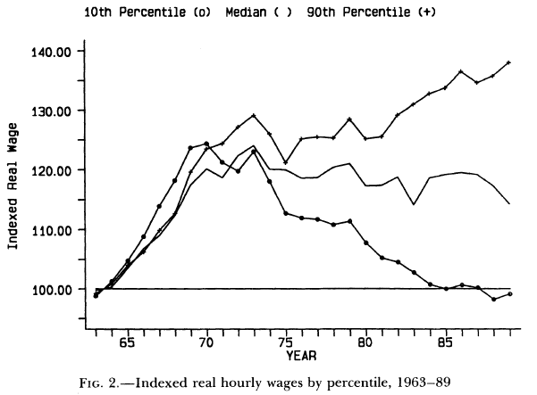
Juhn, Murphy and Pierce, “Wage Inequality and the Rise in Returns to Skill”

Slide 12
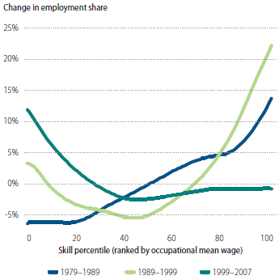
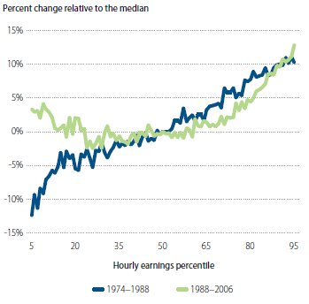
Autor, Figures 1 and 2
Low-end and High-end occupations grew relative to middle occupations
High-end wages grew relative to middle-end wages
Notes:
Percentiles from 1980 PUMS
Shares sum to 1 so growth is relative to whole

Slide 13
LS
Min W
W
LD
Number workers

Slide 14
Supply Side – Changes in Labor Force Size and Composition
Increasing educational attainment
Participation among women
Declining participation among male minorities
Growth in immigrant population
If changes are spread evenly across occupation or wage distribution, these supply effects could not drive polarization.

Slide 15
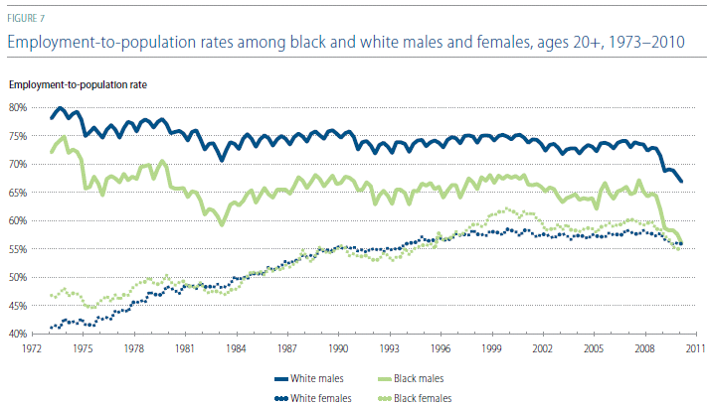
Long-term Trends in Labor Market Participation for Men and Women

Slide 16

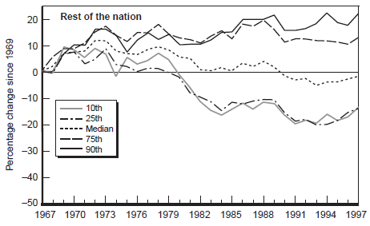
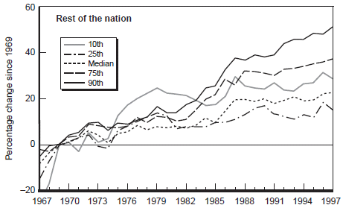
Long-term Trends in the Distribution of Earnings for Men and Women
Notes:
Reed 1999

Slide 17
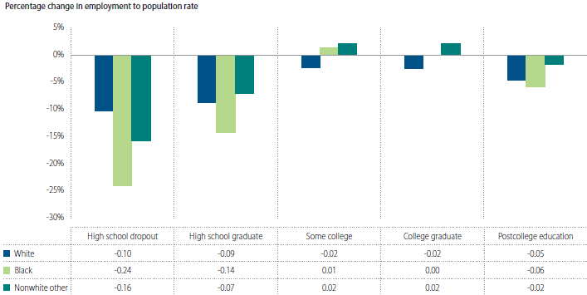
Changes in Labor Force Participation among Men

Slide 18
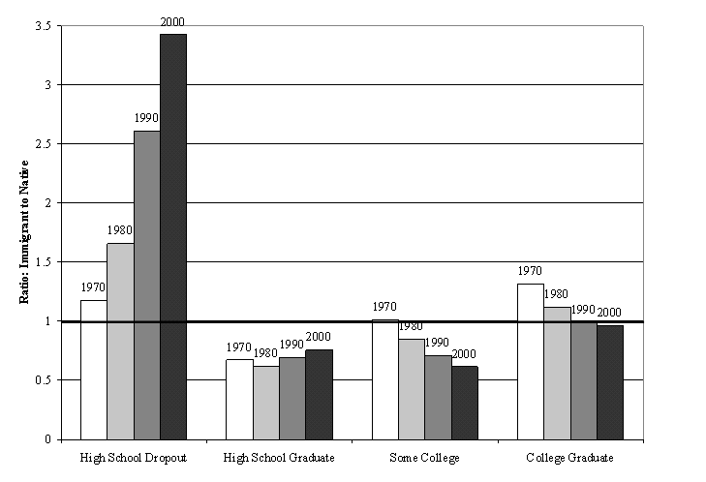
Long-term Trends in Immigration: Educational Composition

Slide 19
LS
W
W*
LD
Wages and employment go in opposite direction
Number workers

Slide 20
Demand Side Hypotheses for Labor Market Polarization
Technological change
Offshoring/Change in industrial structure
International trade

Slide 21
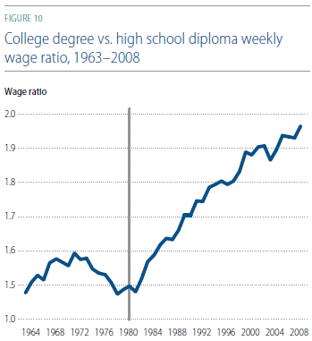
Increasing returns to education

Slide 22
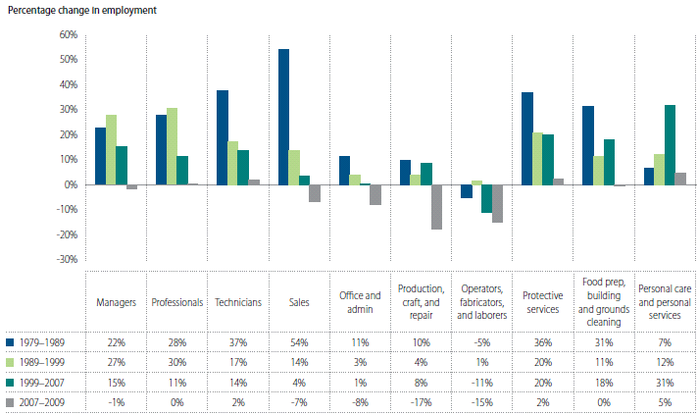
Autor, Figure 3

Slide 23
Institutions Hypotheses for Labor Market Polarization
Minimum Wage
Unionization

Slide 24
Min W falling
Notes:
US real family income

Slide 25

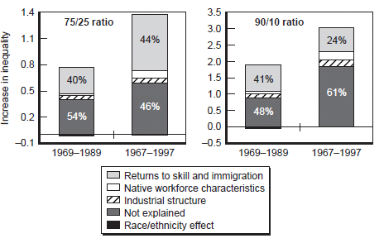
Notes:
CA only

Slide 26
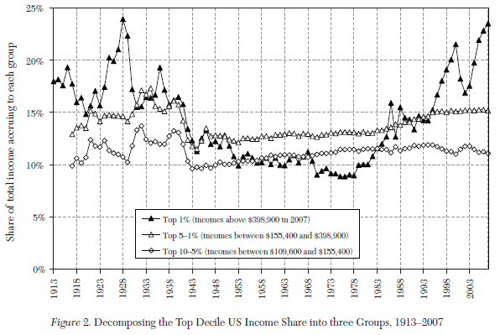
Atkinson, Picketty and Saez (2011)
Notes:
Atkinson Picketty and Saez

Slide 27
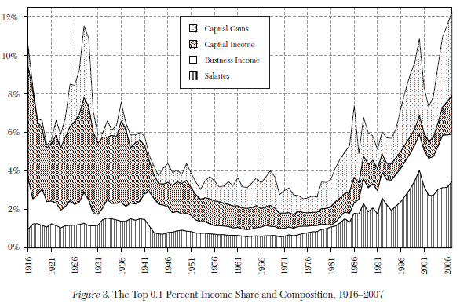
Notes:
Atkinson Picketty and Saez

Slide 29
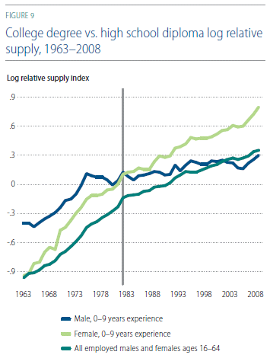

Slide 30
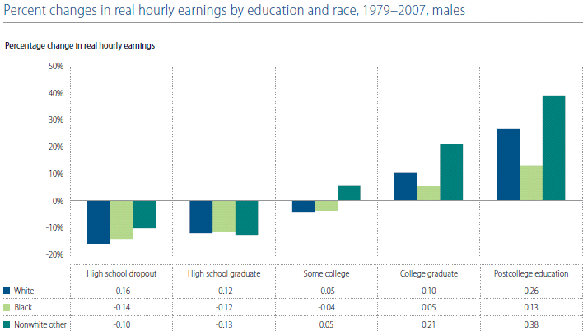

Slide 31
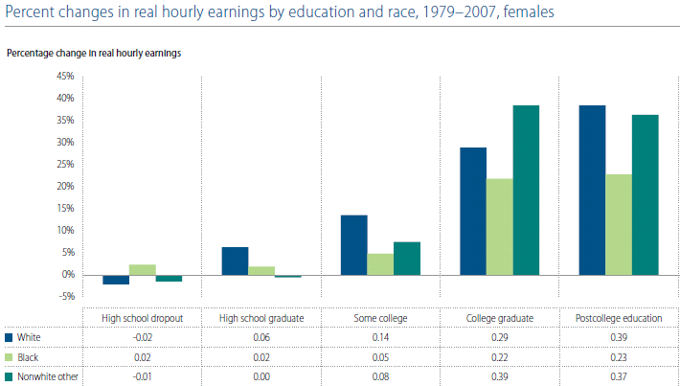

Slide 32
Washington Post op-ed
Economic redistribution can meet some basic needs. We provide food stamps to relieve hunger or vouchers to make housing more affordable. But social equality is not achieved through redistributing cash. "Our research," argue Isabel Sawhill and Ron Haskins of the Brookings Institution, "shows that if you want to avoid poverty and join the middle class in the United States, you need to complete high school (at a minimum), work full time and marry before you have children. If you do all three, your chances of being poor fall from 12 percent to 2 percent."
So the main reasons for inequality are failing schools, depressed and dysfunctional communities and fragmented families. For the most part, inequality does not result from a lack of consumption by the poor but from a lack of social capital and opportunity. Addressing these challenges is more complex than fiddling with the top tax rate.
Economic inequality can be justified as the reward for greater effort - so long as there is also social mobility. In the absence of mobility, capitalism becomes a caste system.

Slide 33
Robert Reich, Secretary of Labor under Clinton:
Between 2002 and 2007, the bottom 99 percent of incomes grew 1.3 percent a year in real terms, while the incomes of the top 1 percent grew 10 percent a year. During these years, the top 1 percent accounted for two-thirds of all income growth.
Over the past three decades, the top 1 percent's share of national income has more than doubled. So there's no reason the top 1 percent should continue to get the Bush tax cut. The top 1 percent spends a much smaller proportion of their income than everyone else. That means there's very little economic stimulus at these lofty heights.
…
Inequality continues to widen in America. But an especially wide chasm has opened between the upper-middle class - including lawyers, doctors and small-business owners - who earn up to $500,000 a year, and the truly privileged who now occupy top perches in executive suites and on Wall Street, and who pull in millions if not billions.
The political power of this top 1 percent is evident in everything from hedge-fund and private-equity-fund managers, who can treat their incomes as capital gains (subject to a 15 percent tax), to multimillion-dollar home-interest deductions on executive mansions.
"We have got to address this inequality, or it will derail the economy,”
Notes:
Conservative supply-siders who argue that the top 1 percent will stop working as hard if they have to return to the 39 percent marginal rate of the Clinton years must be smoking something (probably an expensive grade). Incomes in the top 1 percent are just about the only ones now rising. (Wall Street just announced a 5 percent increase in this year's bonus pool, for example.) Besides, the Clinton years weren't exactly bad years, economically, for the top 1 percent. They did wonderfully well then, too.
And the Bush tax cuts never trickled down. To the contrary, between 2001 and 2007, the median wage dropped. And Bush's record on jobs was pitiful.
Read more: http://www.sfgate.com/cgi-bin/article.cgi?f=/c/a/2010/11/20/IN0E1GD112.DTL#ixzz1LbP1Xrs4
Reich argues that middle class is consumption engine of economy – inequality and shrinking middle class problematic for future of consumption.

Slide 34
Educational attainment | Not seasonally adjusted |  |  | Seasonally adjusted
 | Apr. 2010 | Mar. 2011 | Apr. 2011 | Apr. 2010 | Dec. 2010 | Jan. 2011 | Feb. 2011 | Mar. 2011 | Apr. 2011
Less than a high school diploma
Civilian labor force | 12,225 | 11,565 | 11,703 | 12,079 | 11,758 | 11,383 | 11,317 | 11,652 | 11,567
Participation rate | 46.8 | 45.7 | 46.1 | 46.2 | 46.0 | 45.1 | 45.5 | 46.1 | 45.5
Employed | 10,447 | 9,809 | 10,000 | 10,303 | 9,963 | 9,770 | 9,749 | 10,059 | 9,876
Employment-population ratio | 40.0 | 38.8 | 39.4 | 39.4 | 39.0 | 38.7 | 39.2 | 39.8 | 38.9
Unemployed | 1,778 | 1,756 | 1,703 | 1,776 | 1,795 | 1,613 | 1,568 | 1,593 | 1,691
Unemployment rate | 14.5 | 15.2 | 14.5 | 14.7 | 15.3 | 14.2 | 13.9 | 13.7 | 14.6
High school graduates, no college(1)
Civilian labor force | 38,779 | 37,541 | 37,485 | 38,854 | 38,203 | 37,513 | 37,525 | 37,171 | 37,506
Participation rate | 62.3 | 60.6 | 60.4 | 62.4 | 60.9 | 60.3 | 60.3 | 60.0 | 60.4
Employed | 34,723 | 33,604 | 33,886 | 34,763 | 34,465 | 33,972 | 33,965 | 33,654 | 33,881
Employment-population ratio | 55.8 | 54.3 | 54.6 | 55.8 | 54.9 | 54.6 | 54.6 | 54.4 | 54.6
Unemployed | 4,056 | 3,937 | 3,599 | 4,091 | 3,738 | 3,541 | 3,560 | 3,517 | 3,626
Unemployment rate | 10.5 | 10.5 | 9.6 | 10.5 | 9.8 | 9.4 | 9.5 | 9.5 | 9.7
Some college or associate degree
Civilian labor force | 36,547 | 36,519 | 36,463 | 36,650 | 36,809 | 36,841 | 36,784 | 36,653 | 36,637
Participation rate | 70.8 | 69.5 | 69.3 | 71.0 | 70.2 | 70.2 | 69.5 | 69.7 | 69.7
Employed | 33,590 | 33,708 | 33,829 | 33,625 | 33,821 | 33,878 | 33,919 | 33,938 | 33,907
Employment-population ratio | 65.1 | 64.1 | 64.3 | 65.1 | 64.5 | 64.6 | 64.1 | 64.6 | 64.5
Unemployed | 2,957 | 2,811 | 2,634 | 3,025 | 2,988 | 2,963 | 2,865 | 2,715 | 2,730
Unemployment rate | 8.1 | 7.7 | 7.2 | 8.3 | 8.1 | 8.0 | 7.8 | 7.4 | 7.5
Bachelor's degree and higher(2)
Civilian labor force | 45,794 | 46,979 | 46,913 | 45,839 | 46,312 | 46,263 | 46,591 | 46,919 | 46,897
Participation rate | 77.2 | 77.0 | 77.0 | 77.2 | 76.9 | 76.4 | 76.9 | 76.9 | 77.0
Employed | 43,778 | 44,943 | 44,976 | 43,641 | 44,095 | 44,322 | 44,588 | 44,843 | 44,789
Employment-population ratio | 73.8 | 73.6 | 73.8 | 73.5 | 73.2 | 73.2 | 73.6 | 73.5 | 73.5
Unemployed | 2,015 | 2,036 | 1,937 | 2,198 | 2,217 | 1,941 | 2,003 | 2,076 | 2,109
Unemployment rate | 4.4 | 4.3 | 4.1 | 4.8 | 4.8 | 4.2 | 4.3 | 4.4 | 4.5
Footnotes (1) Includes persons with a high school diploma or equivalent. (2) Includes persons with bachelor's, master's, professional, and doctoral degrees.
NOTE: Updated population controls are introduced annually with the release of January data.
Notes:
BLS
Table A-4. Employment status of the civilian population 25 years and over by educational attainment
HOUSEHOLD DATA
Table A-4. Employment status of the civilian population 25 years and over by educational attainment [Numbers in thousands]

